Slide 1



Classroom resources
Teachers’ welcome pack

Slide 2

Our aim
The BBC’s media literacy work aims to build communities of students,
schools and teachers who will be able to
sift facts from the fake and understand online information better.

Slide 3
Your aim
The classroom resources objectives are to:
understand what ‘fake news’ is
understand meanings and motives behind ‘fake news’
develop critical thinking tools to spot ‘fake news’
develop technology skills to spot ‘fake news’
stay safe online
This resource is aimed for Grades 9-12

Slide 4
The BBC’s media literacy work
  The BBC has delivered media literacy to school aged students all over the world; UK, India (where over 7,000 young people received a workshop) Brazil, Europe, Africa, Myanmar
  BBC contributed to the curriculum of Factshala, an Internews/Dataleads media literacy programme in India sponsored by Google News.

Slide 5
BBC Values
It might be helpful to you to understand the BBC’s values.
All BBC news, programmes and output
are built upon the following values:
accuracy, impartiality, respect, trust
These values are also at the core of the BBC’s media literacy material.

Slide 6


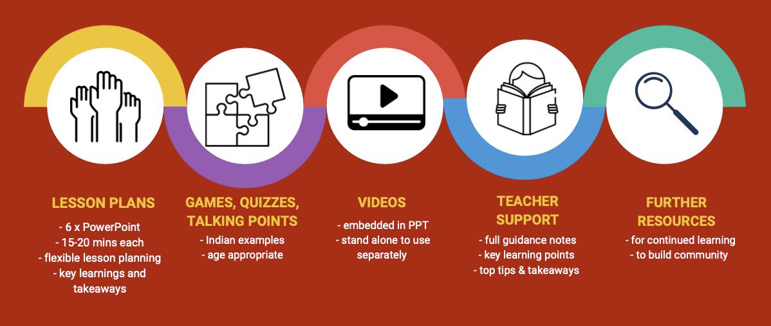

Your kit of parts…

Slide 7

There are 6 Power Points (PPT)
Each PPT is on a different topic
The PPTs build learning, starting with an
      introduction to ‘fake news’, progressing to
critical thinking tools to technology tools
Each PPT lasts 15-20 minutes
  (depending on time given to participation)
This allows for flexibility in lesson planning

Slide 8

Here are some useful resources;
https://www.bbc.com/beyondfakenews/
https://www.bbc.com/news/world/asia/india
https://dataleads.co.in
https://internews.org/region/india/
https://www.boomlive.in
https://firstdraftnews.org

Slide 9
Thank You
© BBC 2022
These workshops and slides are for educational and private study use only. They are not for resale or commercial and/or online distribution.
if you wish to use the workshops and slides for any other purpose, please contact marie.helly@bbc.co.uk

