Slide 1



A media education programme for school students in India launched by BBC News in partnership with Internews and in collaboration with DataLEADS
Notes:
A media education programme for school students in India launched by BBC in partnership with Internews and in collaboration with DataLEADS

Slide 2

AGENDA
Introduction to ‘Fake News’
Who shares ‘Fake News’ and why
How do we check if it is REAL
Social media and image verification
Video verification

Slide 3

What is ‘fake news’?
Do you know what is ‘fake news’?
Did you ever fall for ‘fake news’?
What did you do with it?

Slide 4
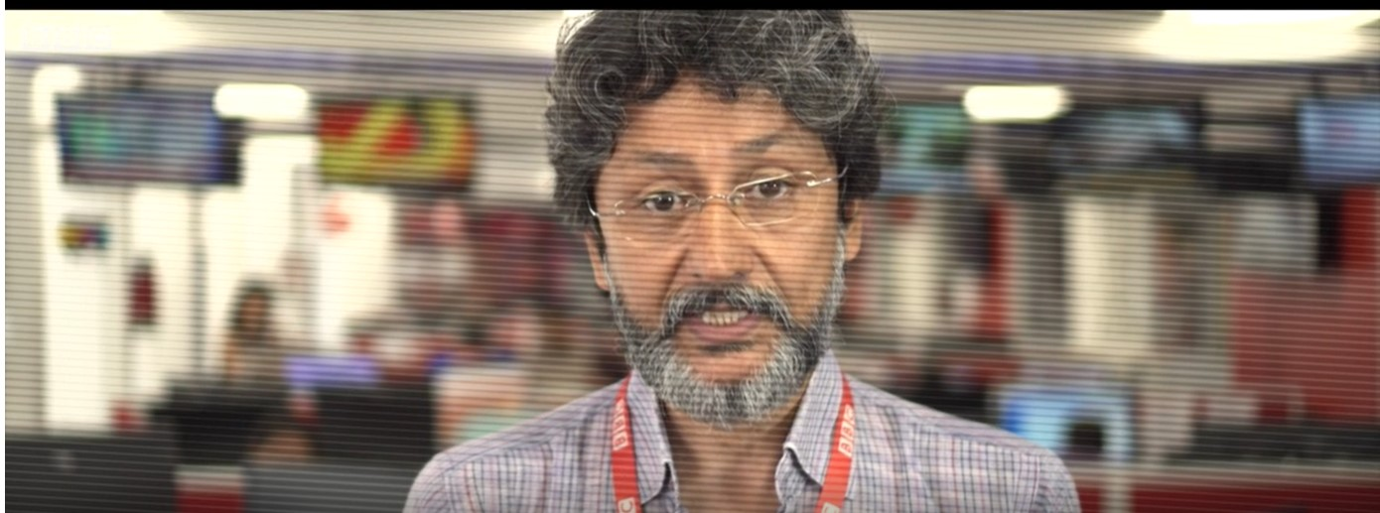

Introduction to Fake News
Video Link
Notes:
Introduction to Fake News - BBC Video
Play video: runtime 4 minutes 15 sec

Slide 5
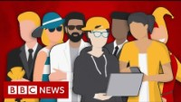
Who makes it? Who shares it? – And why?

Slide 6

REAL Checks
REAL
EVIDENCE
Is it real?
What is the source?
Ask around, use your knowledge
Any other sources carrying the story?
ADD IT ALL UP
LOOK AROUND

Slide 7
The REAL Checks – Four Steps
Real: “Is this real?”
Evidence: Check the source, author, publication, web address, date & time, pictures, text, names (5Ws, 1H)
Add it all up: Does it add up with what you knew or can find out ?
Look around: Check other sources to see if they are carrying the story

Slide 8
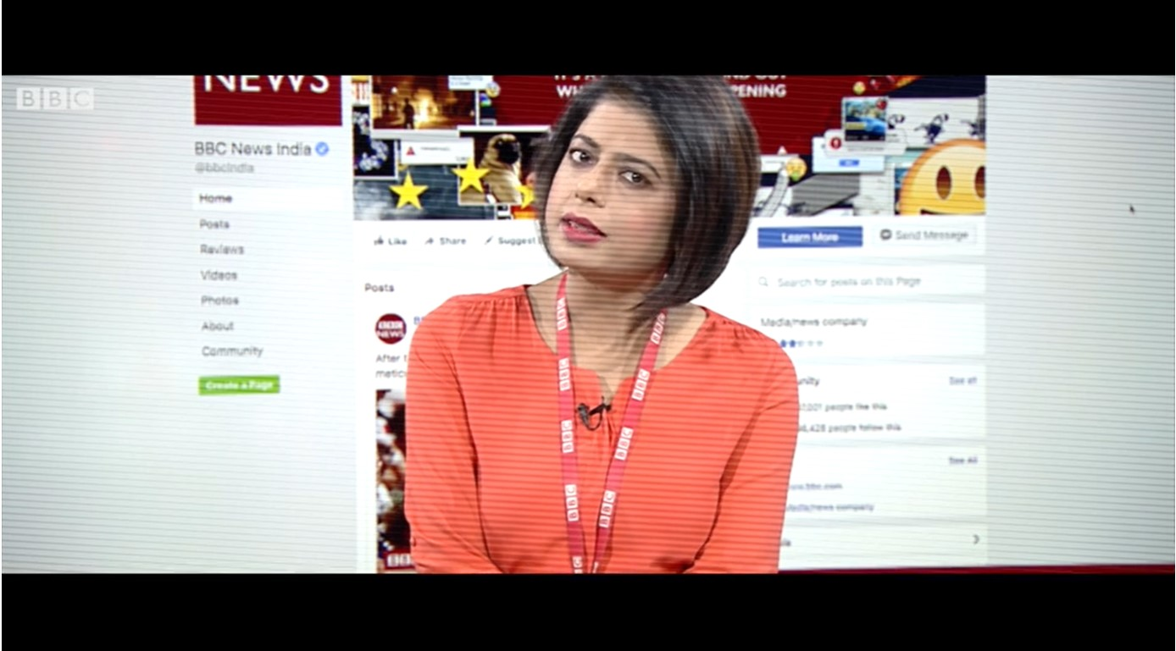
BBC Video: The REAL check
Video Link

Slide 9
5Ws,1H: The journalist’s questions
Who?
Who wrote it? Who published it? Who sent it?
Who else has this story?
What?
What is the story? What is the evidence?
What is the motive?
Where?
Where else is this information? Where else have I seen this story? Where else does this photo appear?
When?
When did this happen? When was it written? When was the photo taken? When did I receive it?
How?
How does it want me to feel or think? How does the author know?
Why?
Why have I been sent it? Why has it been written?

Slide 10
‘Click Away’ To Look Around

Slide 11
Do a simple Text Search on Web
Look at what other sources are saying
Check authoritative sources and official websites

Slide 12

What and who to trust?
Video Link

Slide 13
Top tips for verifying photos & videos
Ask: Is it REAL?
Does this picture appear anywhere else?
Try text search, reverse image search to find context
Observe signs, shop names, posters, car registration, landmarks
Clothing, behaviour, people’s expressions

Slide 14
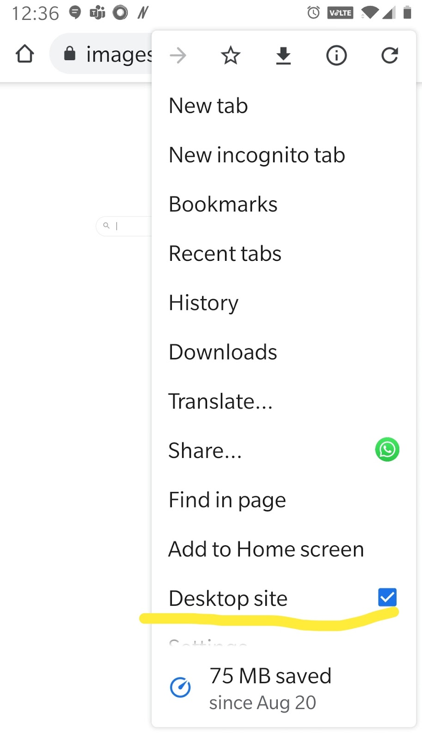
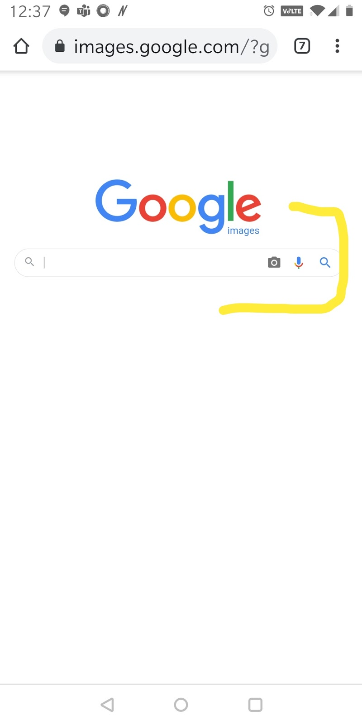
To use Google Reverse Image Search on mobile, go to desk top site

Slide 15
Remember: You can use “text search” to verify videos too
A simple text search of what you see in the video can get you to the actual video
Make sure you use minimum words for the search phrase - this will give you focussed results

Slide 16

Top tips for videos
Check if the video is edited shorter and taken out of context
Check when the video was originally posted, since it might be re-used
Check where the original video was posted, as videos can be taken out of geographical and cultural context
Check the original tags, as they may be deliberately mislabeled

Slide 17
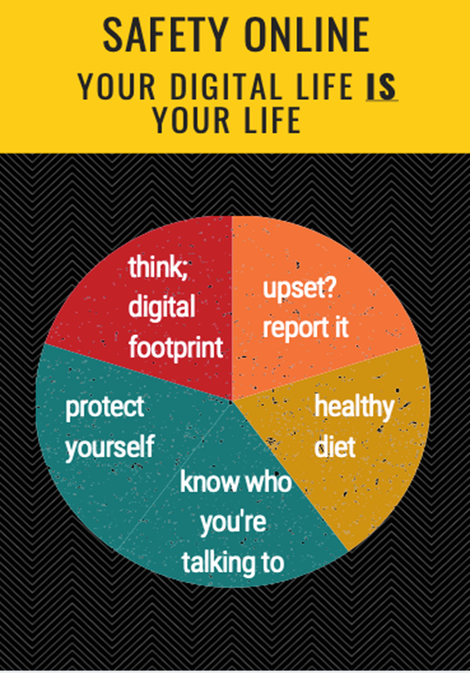

Slide 18
Tips for being secure online
Seek Help! know how to report to service providers and use blocking and deleting tools.
Upset online? it’s never too late to tell someone, ask a trusted adult
Respect the law: use reliable services and know how to legally access the music, film and TV you want.
Remember what you post can be there forever. So don’t post anything you wouldn’t want Grandma to see!
Beware of writing things in haste that you may later regret

Slide 19
Tips for being secure online
Who are you? Ignore friend requests from people you may not know
Who am I? Avoid giving out personal information, like your number, where you live or what school you go to
Steer clear of engaging with a bully or a person who trolls you
Never participate in group trolling against others
If you get responses that are threatening in nature, bring it to the notice of elders
Make sure you “unfollow” and “unfriend” people who indulge in unacceptable online behavior.
Choose strong password and not along the likes of “12345”
Have a healthy diet both on and offline

