Slide 1


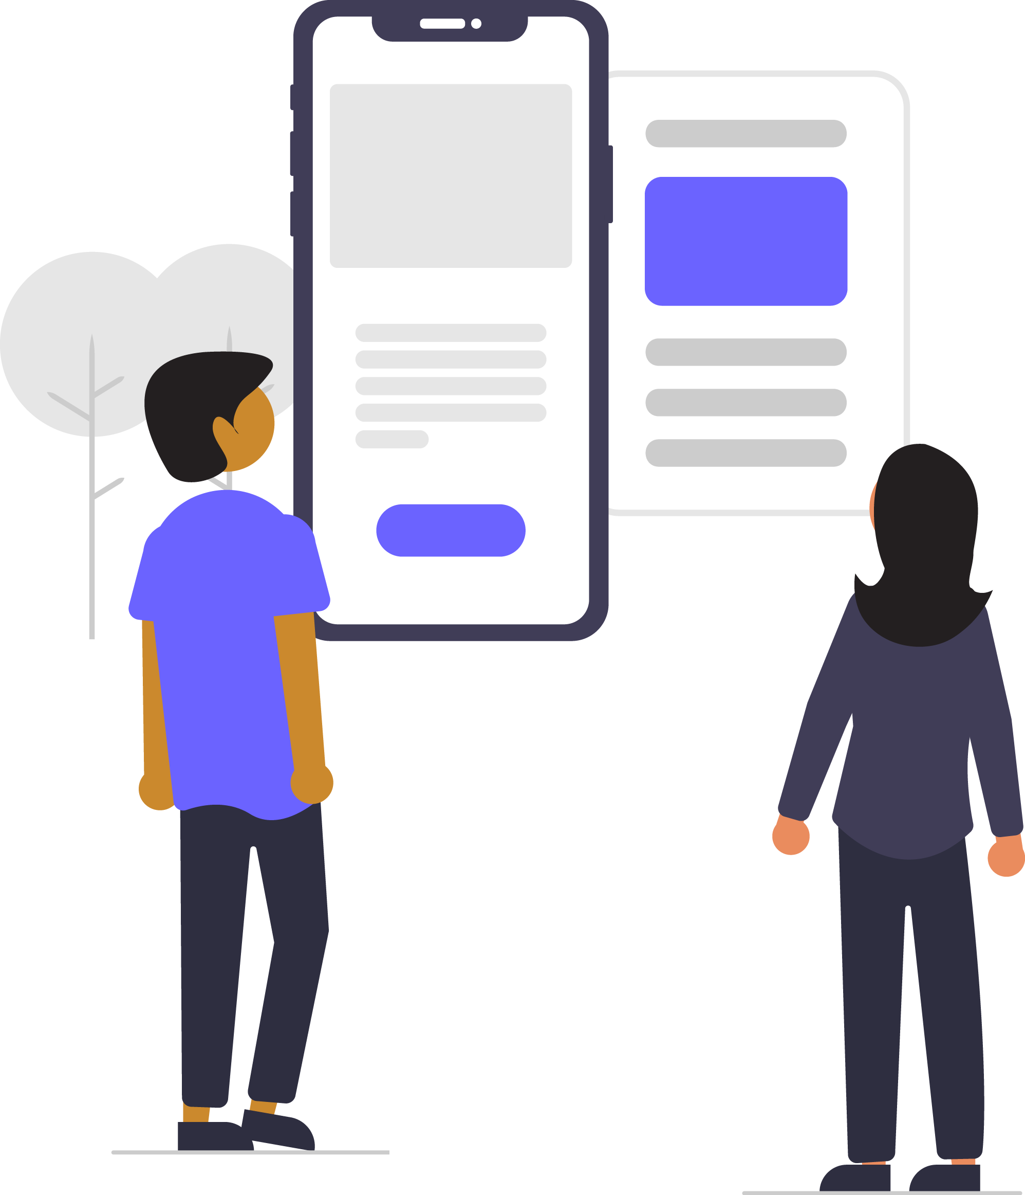
Digital skills for life
Classroom resources
Module 5
Techie tools
Notes:
This is the first slide of the BBC Young Reporter classroom resources/lesson plans.
Module 5: Techie Tools
Duration: approximately 20 minutes
Resources needed: PPT and/or PDF
Audio-visual player if available.
Internet connection – it’s ideal if you can have a go at these tools either together or at students’ desks. It’s all about giving it a go!

Slide 2
Objectives
For this lesson:
To learn skills that the tech savvy use to help them spot ‘fake news’
To apply these skills to real life examples

Slide 3




Recap…
Notes:
Recapping - In lesson 1, we learned this top tip; pause before you share. In lesson 2, we learned to ask questions. In lesson 3, we learned about sources, and how to figure out who to trust. In the last lesson we learned some tricks of the trade – click away to other sites to cross reference, and to look for the signs, like platform verification symbols. In this lesson, we are going to look at some technical tools that can help you verify a story.

Slide 4
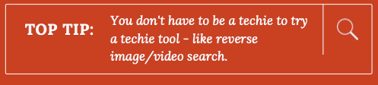
This lesson’s top tip is
Notes:
So the top tip in this lesson is that you don’t have to be a techie to try a technical tool. The two tools we will learn here are really easy to use, they take the user step by step. Give it a try – there is nothing to lose!

Slide 5
How can I tell if an image is real? known as photo verification
Notes:
There are technical things you can learn to do that can help you discover if a story of piece of information is real or fake. One is ‘reverse image’ search. Ask your students if anyone knows what this is.

Slide 6
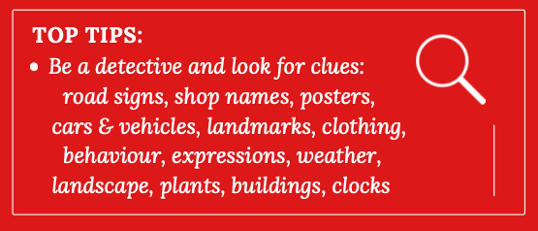
To check photos – look closely
Still not sure….?
Notes:
These things you can already do – looking really closely can often tell you what you need to know. You can find pictures online and discuss with the students the details they can look for and what might indicate to them that something is not right. Is the weather right for the story? Do the road signs or the car registrations tell you where the picture was taken?

Slide 7
Reverse Image Search
The techie’s tricks:
Notes:
There are technical things you can learn to do that can help you discover if a story of piece of information is real or fake. One is ‘reverse image’ search. Ask your students if anyone knows what this is.

Slide 8

What can a
Reverse Image Search tell you?
if an image has previously been posted on the internet
if an image has been manipulated
if an image was previously used in a different context
the source of an image
Notes:
This is what a reverse image search can tell you…

Slide 9
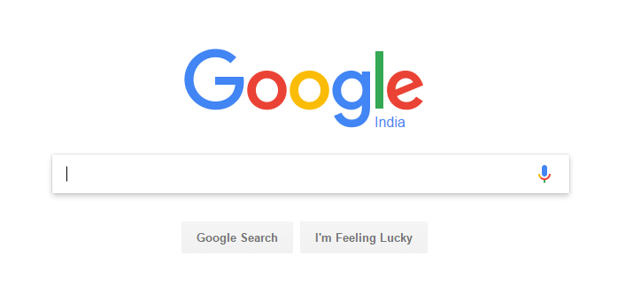
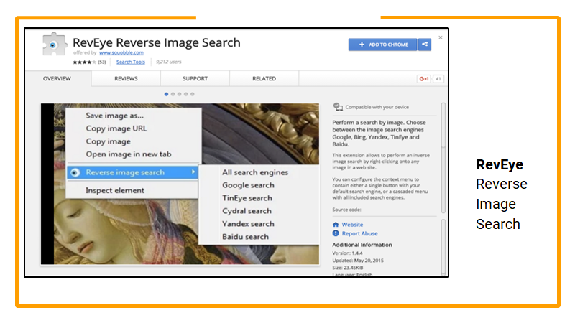
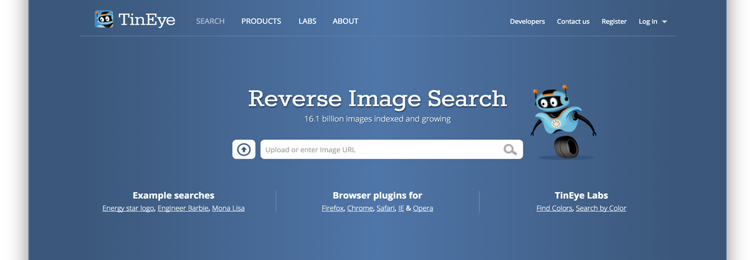
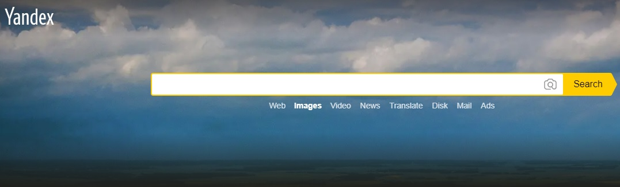
Sites that can verify images
GOOGLE REVERSE IMAGE SEARCH
REVEYE – PART OF INVID CHROME EXTENSION
TINEYE REVERSE IMAGE SEARCH
YANDEX REVERSE IMAGE SEARCH
Notes:
There are plenty of reverse image search tools. Here are four. Most of them are self explanatory and involve uploading an image into their search box, after which the site will offer you results as to where these images can be found.

Slide 10


How to Google Reverse Image Search
Go to: support.google.com
In the search box type: reverse image search
the results will tell you how to search in different ways
eg. upload a picture, drag & drop, copy & paste
Notes:
If you go to Google support you will find lots of ways of searching for information including reverse image searches.
https://support.google.com/search?q=reverse+image+search&from_promoted_search=true
Google News Iniative is also a great source of easy guides to searching online, including images, but also text
https://newsinitiative.withgoogle.com/resources/journalism/verification/lessons/verification-advanced-reverse-image-search/#
Activity - Share an image which went viral on social media and ask the group to reverse search. What can they find out about the image?

Slide 11
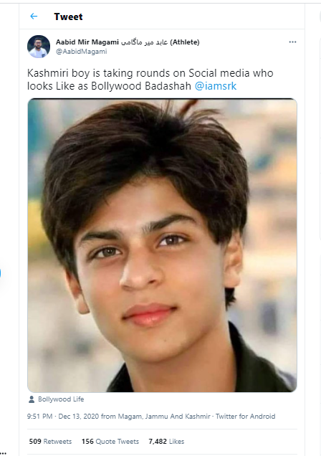
This is a look-alike of Bollywood actor Shahrukh Khan from Kashmir.
True or False?
Notes:
Follow the slides through to see how you can discover if this is a real photo of Shahrukh Khan.

Slide 12
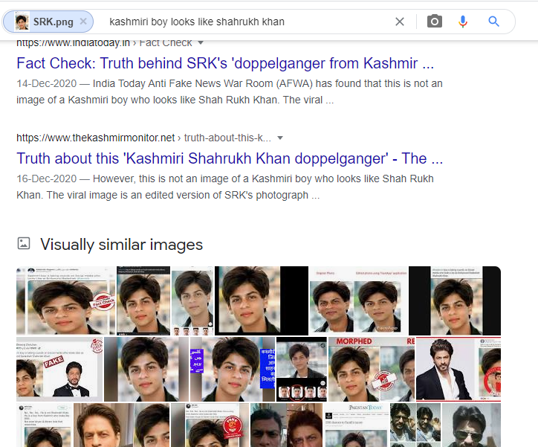
When you Reverse Image Search you get these results

Slide 13
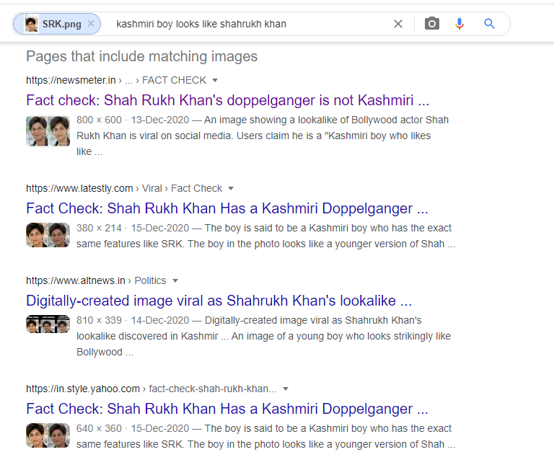
And you also get these results
Notes:
What do these results tell you?

Slide 14
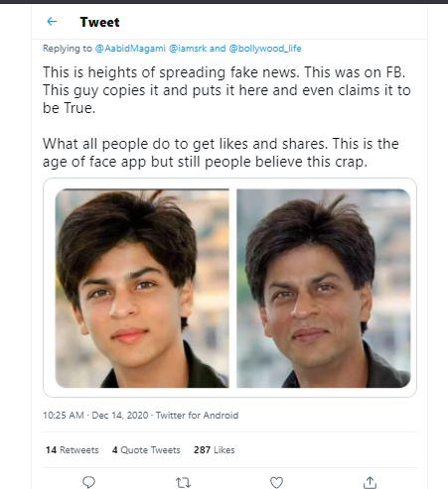
The image is digitally generated or altered.

Slide 15
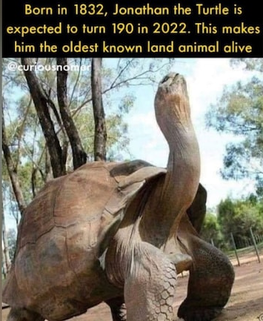
This is Jonathan the tortoise - the oldest living animal today.
True or False?
Notes:
If you are able to, either demonstrate or ask the students to do it themselves, carry out a reverse image search to see if the story is real.
This link will show you a fact check on this story.
https://www.indiatoday.in/fact-check/story/fact-check-this-is-not-jonathan-the-tortoise-world-s-oldest-living-animal-1820912-2021-06-29

Slide 16
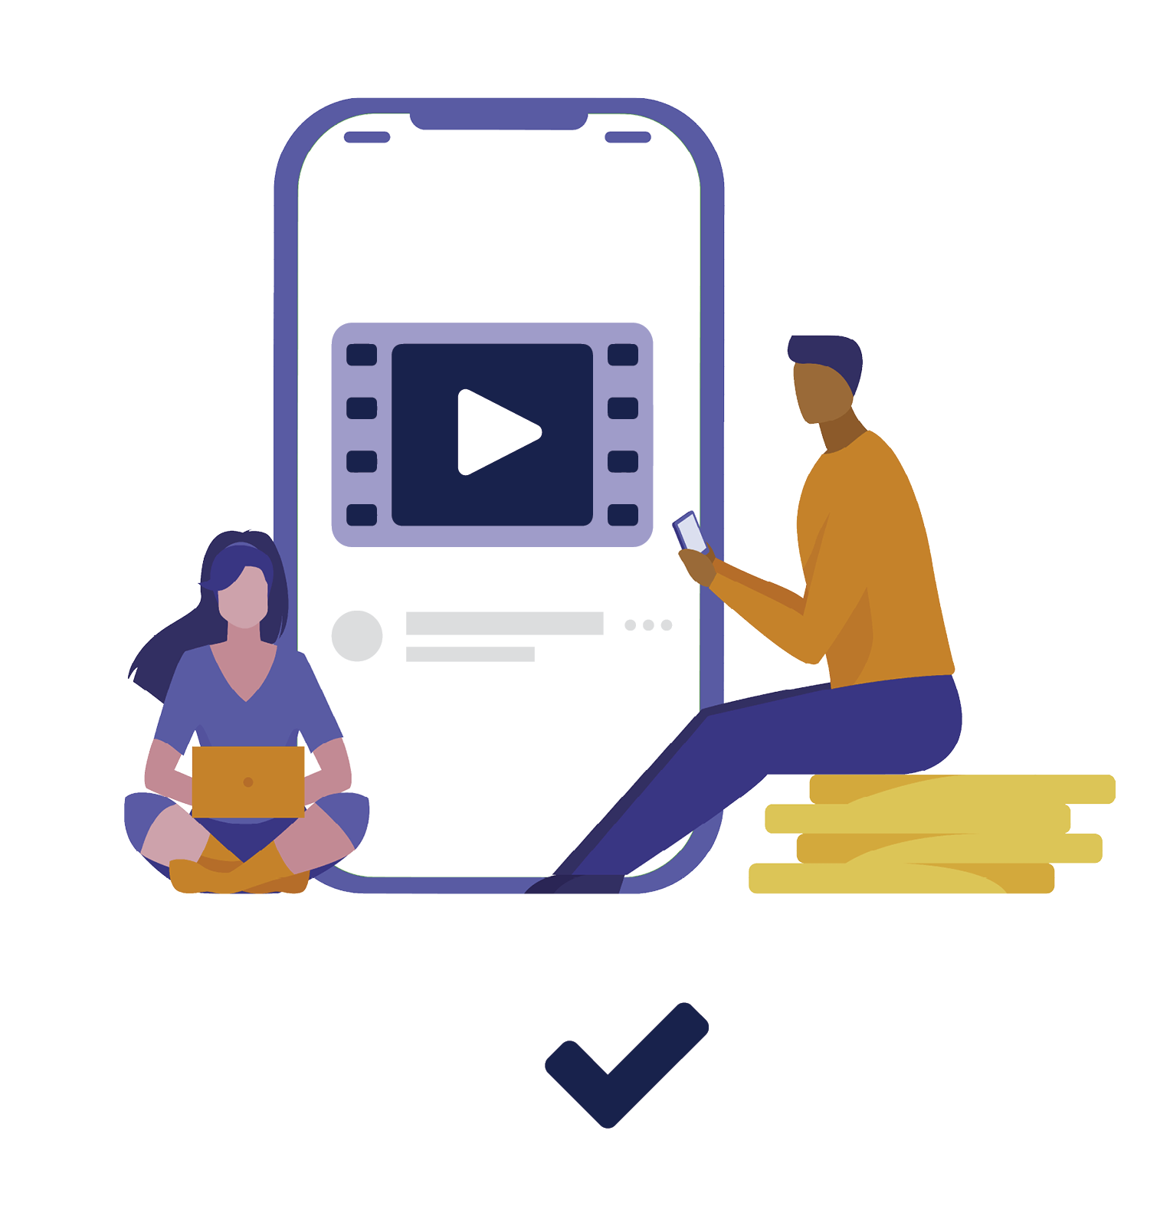
Why is video verification important?
Consumed, believed and trusted easily
Creates instant panic, and chaos
Can quickly go viral and cause harm
Can be smartly edited
Can easily be repurposed with new narratives
Notes:
Why is video verification important? Discuss with your students, including some of the ideas listed here.

Slide 17
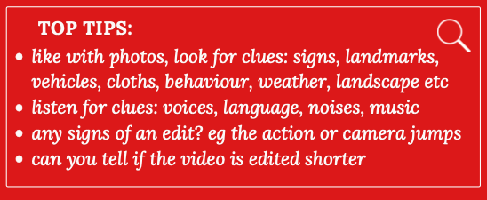
To check videos – look closely
Still not sure….?
Notes:
These things you can already do – just like with photos, there are plenty of things you can do to spot if a video is accurate, without doing any technical tricks at all.

Slide 18
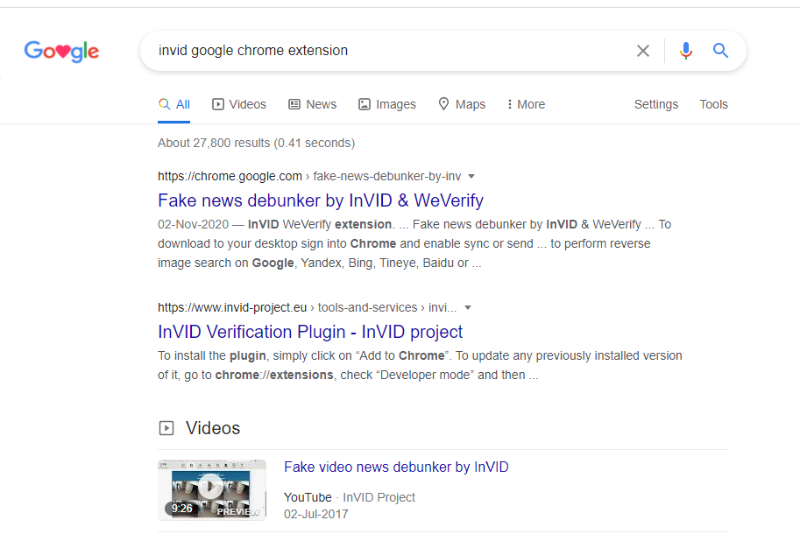
To reverse search a video begin with downloading the InVID Chrome Extension
Notes:
You can try thjs in your classroom. The slides will take you through a version of the process.

Slide 19
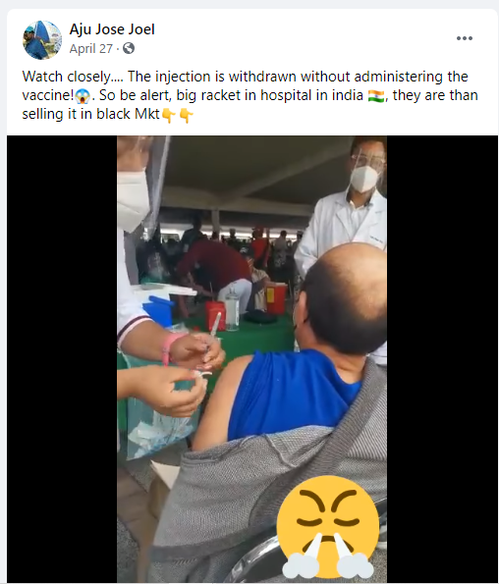
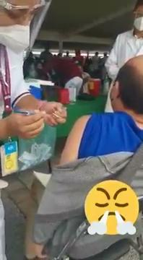
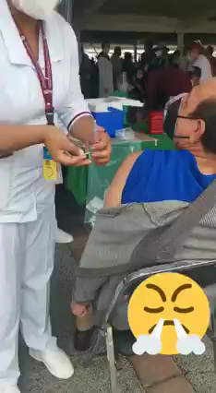
This image comes from a video shared as vaccine fraud in India.

Slide 20
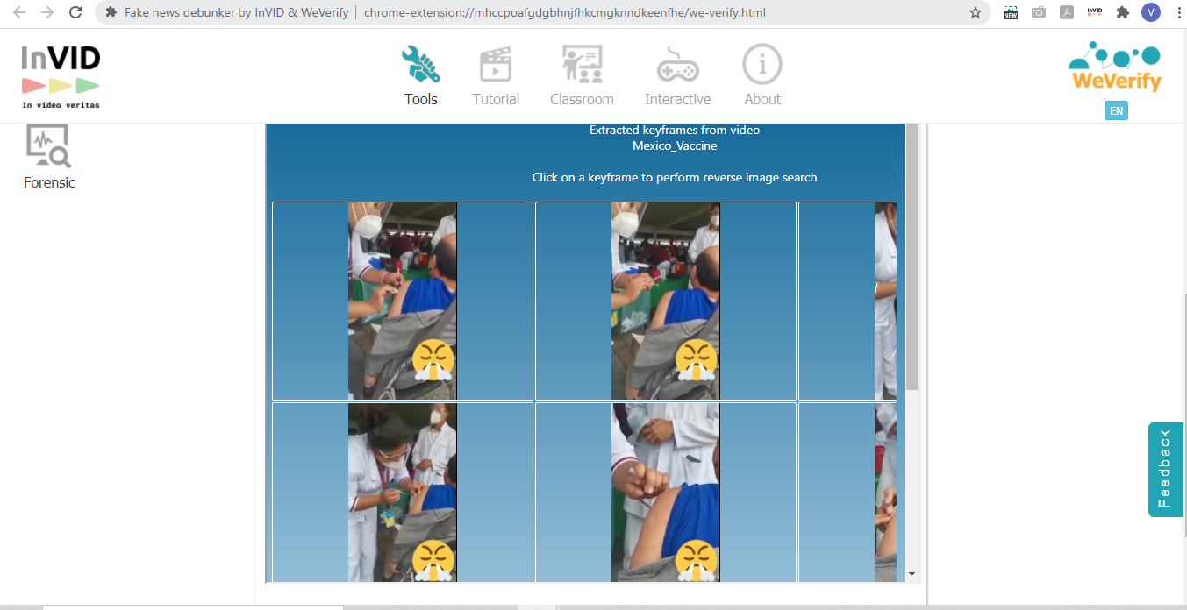
Using InVID, we can break down the video into keyframes, and then use these still frames to do Reverse Image Search

Slide 21
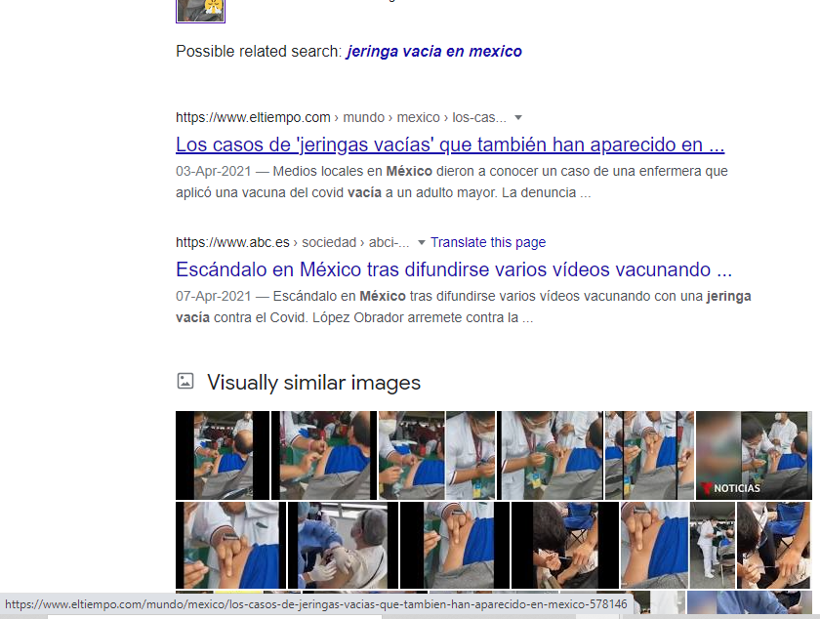
The results we get are in Spanish, alerting us that this video may not be from India
Notes:
Sometimes, it is enough to cast doubt on a story, and consider that it is probably not true, or is misleading in some way. Checking for misinformation does not mean you also have to get to the bottom of the whole story, for example discovering where the photo really does come from. Casting doubt may be enough for you, and it may help you decide not to share.

Slide 22
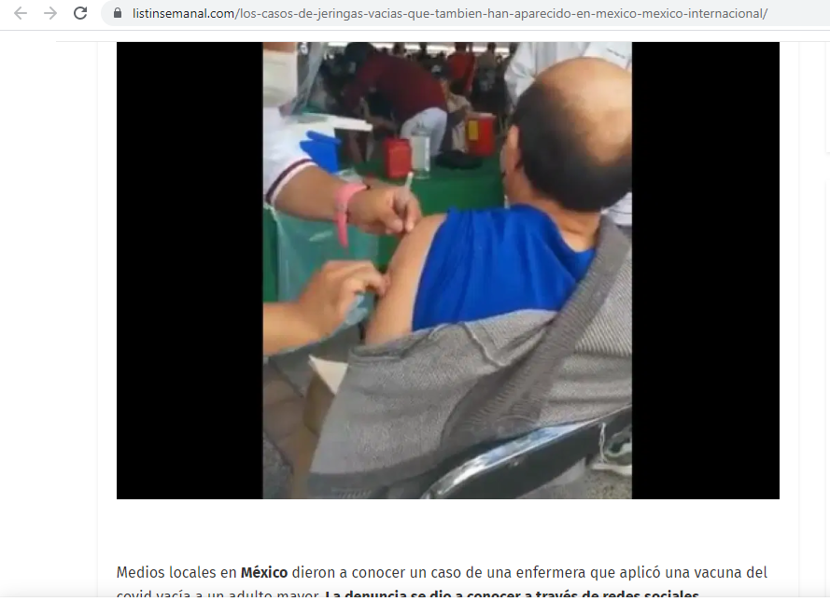
This is in fact a video from Mexico, not India
Notes:
A deeper look at the story and it becomes clear that the story is from Mexico.

Slide 23

A reverse image search can indicate
- if the video has posted before, and has been re-used
- where and why the video was originally posted, and has been taken out of context
- check whether the descriptions have been deliberately mislabelled
Notes:
These are the clues your reverse image search can provide.

Slide 24
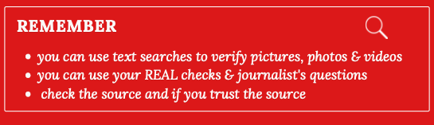
Notes:
Even before you do a technical search on a story or picture, you can use the questioning tools we have learned in previous lessons.

Slide 25
This lesson’s top tip is
WATCH THIS FILM TO CONSOLIDATE YOUR LEARNING
How the BBC verifies content from Ukraine
https://www.bbc.com/news/av/61096713
Notes:
So the top tip in this lesson is that you don’t have to be a techie to try a technical tool. The two tools we will learn here are really easy to use, they take the user step by step. Give it a try – there is nothing to lose!

Slide 26
End of module 5
Techie tools
© BBC 2022
These workshops and slides are for educational and private study use only. They are not for resale or commercial and/or online distribution.
if you wish to use the workshops and slides for any other purpose, please contact marie.helly@bbc.co.uk
Notes:
This is the last slide of the BBC Young Reporter classroom resources/lesson plans.
Module 5: Tricks of the Trade
Duration: approximately 20 minutes
Resources needed: PPT and/or PDF
Audio-visual player if available.

