Slide 1


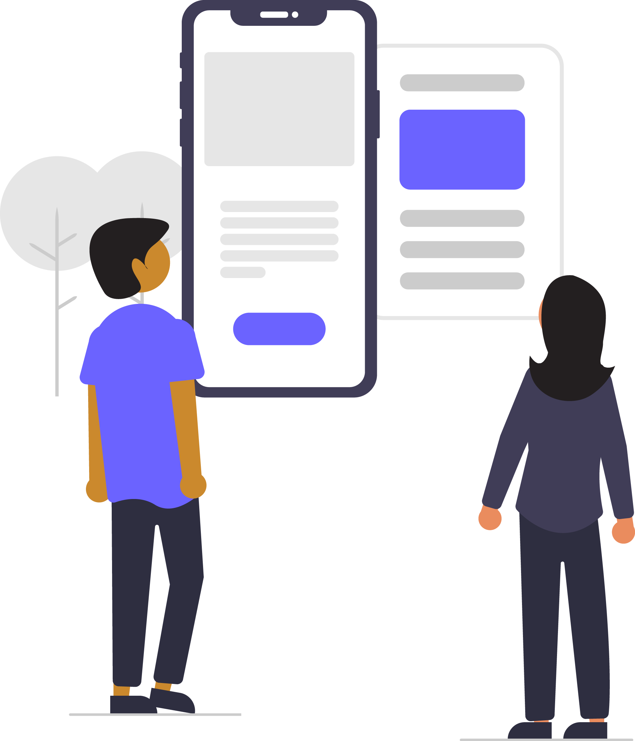
Digital skills for life
Classroom resources
Module 3
Sources and trust
Notes:
This is the first slide of the BBC Young Reporter classroom resources/lesson plans.
Module 3: Sources and Trust
Duration: approximately 20 minutes
Resources needed: PPT and/or PDF
Audio-visual player if available.

Slide 2
Objectives
For this lesson:
learn what a source is for journalists and for you
learn how to know which sources to trust and why
Notes:
In this lesson you will teach the students about sources of information, what a source is – and how you might be able to work out which sources to trust and why

Slide 3


Recap…
Notes:
Top Tip – In lesson 1, we learned this top tip; pause before you share. In the last lesson, lesson 2, we learned to ask questions.
In this lesson, we are going to look at sources – where does the piece of news, the information the message, picture or video you are looking at come from …..

Slide 4

This lesson’s top tip is
Notes:
So the top tip in this lesson is to know your source and to use sources you trust

Slide 5

What or who is a ‘source’?
A source is anything or anyone that provides information
people
organisations, institutions (eg government, your school)
reports
documents, books, minutes of meetings
social media and websites
Can you think of any other sources?
Who might be a good source for a journalist?
Notes:
In this lesson you will teach the students a ‘checklist’ method of verifying information – REAL checks – and also the kinds of questions that journalists ask to verify information.

Slide 6

Source
Who is a journalist’s source(s)?
What does the journalist tell you about their source(s)?
Who/ or which publications are your sources?
Two sources for the same information or story, is probably better than one – many journalists & newsrooms follow this practice.
You can do the same – do you have two sources for your story, two separate sources telling you matching stories or information?
2 Sources
Which source to trust
Can every source be trusted?
How does a journalist decide which source to trust?
How can you decide which source to trust?
Notes:
Sources: Journalists are taught the value of sources, and assessing which sources to trust.
2 Sources: For some crucial bits of information – especially if they are contested, controversial or unpopular - journalists and news organisations often try to ensure they have two sources they believe are reliable before publishing a story.
The rule means that when sourcing information, a fact isn't credible unless it can be verified by two different sources.
Which source to trust; what are the tools or questions that can help a journalist assess who they can trust? Let’s explore this further.

Slide 7

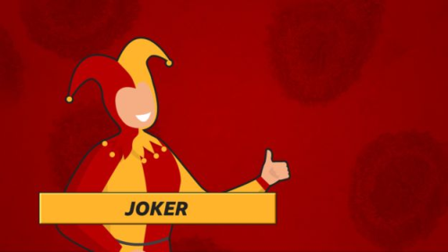
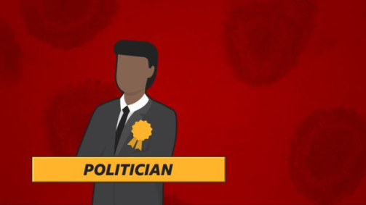
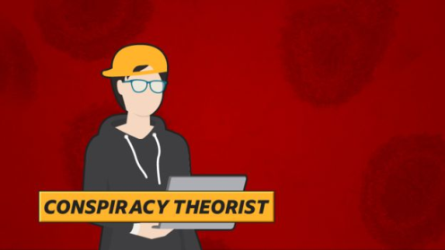
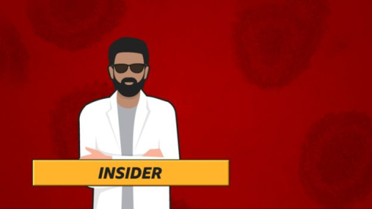
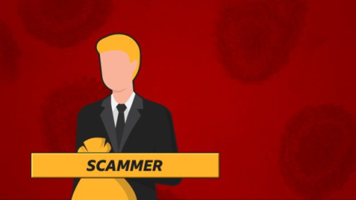
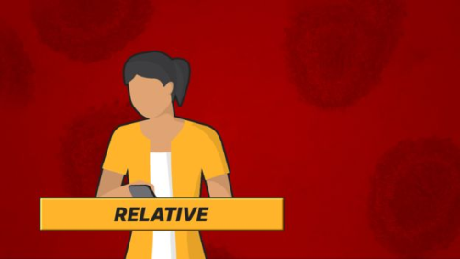
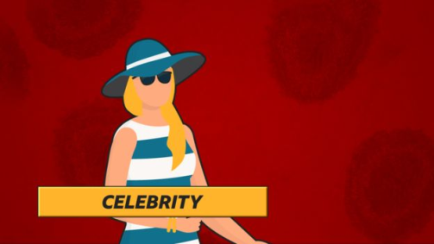
Seven sources of ‘fake news’
Notes:
The BBC’s disinformation team – who help to spot and debunk misinformation and disinformation - have identified seven types of people who create and spread false information and get it to go viral. They are all sources – in this case, they are sources of disinformation. Here they are:
the joker, the politician, the conspiracy theorist, the insider, the scammer, a relative (including friends and family) and celebrities.
Discuss with your students any stories they have seen where one of these ‘actors’ may be behind the story.
Here are some motivations; which motivations go with which person type. Are there other motivations your students can think of?
Mistake - Genuine Error
Satire - Harmless entertainment
Publicity - Propagating a cause
Financial - Usually scams
Ideological - Propagating cause about faiths or community
Political motives - Plying political narratives
Psychological biases - Deep personal likes and dislikes
Cultural backgrounds - Family orientation, cultural settings and values

Slide 8
Discuss: Do these seven sources of ‘fake news’ only operate online?
List other places where sources might not be reliable.
How can a journalist tell if a source can be trusted?
Notes:
An important part of the lesson is to discuss that unreliable sources (eg of ‘fake news’) don’t just operate online. Inaccurate unreliable sources can be found in lots of places – TV, books, magazines, political speeches, community events, witnesses, social media users. It is a part of life; people get things wrong, or they are making a joke, or they have a political point of view, or they claim to be an expert, or they are trying to get money or influence – or perhaps they are deliberately misleading or not telling the truth. See how many other sources your students can think of that might give false/misleading information. You can use the same tools – REAL checks, journalists questions to help you.
Magazines
Political speeches
Historical sources
Reports
Poster campaigns
Leaflets
Interviews
Friends
Family
Witnesses
The video that follows gives a useful guide to how to tell if a source can be trusted.

Slide 9
Who do you trust?
Notes:
The next exercise is a Traffic Light exercise. Suggest some sources to them, and using the kinds of questions raised in the video, how would the rate the source? Completely trustworthy – green, with caution – amber, not at all – red. Questions you might encourage students to ask: what is it I want to know and is this person/source likely to know? What do I know about them? What is their reputation? Have they owned up to and/or corrected previous mistakes?
Here are some suggestions of sources you could ask about:
Taxi driver
National politician
Foreign pop star visiting the country
My mum
Wiki
Local police
Local paper
Train announcer
Teacher

Slide 10
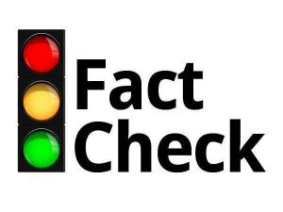
Who to trust? traffic light exercise
Which sources of information do we trust, which should be wary of and which sources should we never trust
PROCEED | WARNING SIGNAL | STOP
Official Statement | Statement without attribution | Statement without evidence
Notes:
Students can create this table in their workbooks and place each source suggested by the teacher in one of the three categories.
Some examples follow.

Slide 11
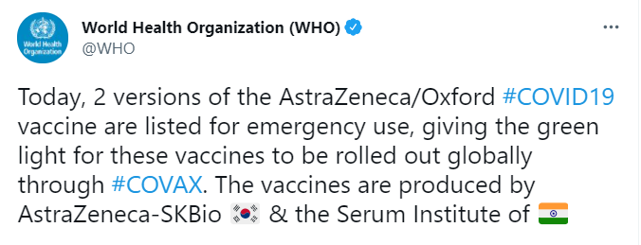
STOP
WARNING
PROCEED
Notes:
Would you trust this source and the information it contains? Ask students to work through their traffic light system, ask them the question from the video; is this source likely to know? What do I know about this source?

Slide 12
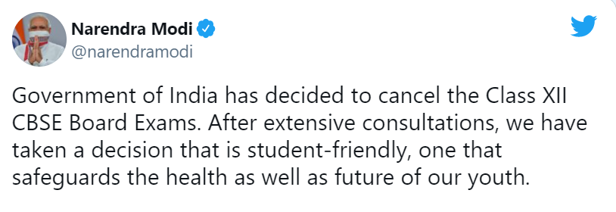
STOP
WARNING
PROCEED
Notes:
Would you trust this source and the information it contains? Ask students to work through their traffic light system, ask them the question from the video; is this source like to know? What do I know about this source?

Slide 13
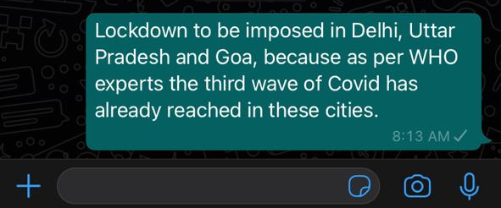
STOP
WARNING
PROCEED
Notes:
Would you trust this source and the information it contains? Ask students to work through their traffic light system, ask them the question from the video; is this source like to know? What do I know about this source?

Slide 14
WATCH THIS FILM TO CONSOLIDATE YOUR LEARNING
https://www.bbc.com/beyondfakenews/what-and-who-to-trust/
Notes:
Here’s the top tip then for this lesson – know your sources and use sources you can trust.

Slide 15
End of module 3
Sources and trust
© BBC 2022
These workshops and slides are for educational and private study use only. They are not for resale or commercial and/or online distribution.
if you wish to use the workshops and slides for any other purpose, please contact marie.helly@bbc.co.uk
Notes:
This is the last slide of the BBC Young Reporter classroom resources/lesson plans.
Module 3: Sources and trust
Duration: approximately 20 minutes
Resources needed: PPT and/or PDF
Audio-visual player if available.

