Slide 1

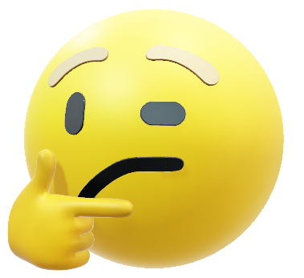
Social Media
mind your manners
Notes:
START
This slide marks the start of What do you see? :Looking at pictures… You can use this slide as a holding slide while waiting to start.
Fake news – or disinformation or misinformation – can include pictures. In fact loads of pictures online or social media have been altered, and could be called ‘fake news’.

Slide 2

Ask around, use your knowledge
ADD IT ALL UP
LOOK AROUND
Notes:
Let’s watch this video…

Slide 3



Ask around, use your knowledge
ADD IT ALL UP
LOOK AROUND
Notes:
This is what happens when we share. If people share one piece of information with just two friends, then in three ‘shares’ that piece of information can go from 1 person to to 8… and after another three shares to 63 people.
In social media there is no one fact checking or filtering the information like there is in a news organisation who have journalist and editorial processes. You have to do this yourself.
If you share information, content or messages that are not real and true – you are spreading ‘fake news’.

Slide 4

REAL checks
REAL
EVIDENCE
Is it real?
What is the source?
Ask around, use your knowledge
Any other sources carrying the story?
ADD IT ALL UP
LOOK AROUND
Notes:
These are the REAL checks. These questions can help us to spot fake social media posts.
R = is it real?
E = Evidence, what evidence is there?
A = Ask questions, ask around and add it up
L = Look around, are there other sources carrying this story.

Slide 5
Share or Don’t Share?
Ask around, use your knowledge
ADD IT ALL UP
LOOK AROUND
Notes:
So let’s see – would you share the following items of social media.

Slide 6

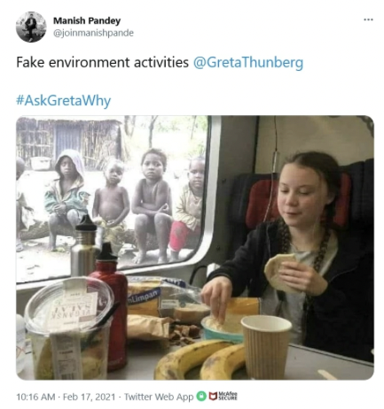
Ask around, use your knowledge
ADD IT ALL UP
LOOK AROUND
Notes:
Do you remember this from the workshop? Would you share this tweet? Do your REAL checks.

Slide 7
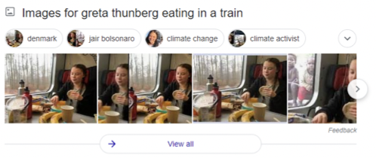
Ask around, use your knowledge
ADD IT ALL UP
LOOK AROUND
Notes:
Looking around for this photo will quickly reveal the real version.

Slide 8

Everything you
need to boost your immunity
against Covid-19
can be found
in your kitchen.
Ask around, use your knowledge
ADD IT ALL UP
LOOK AROUND
Notes:
What would you do if this message arrived in one of your chat groups? Do your REAL checks. What questions would you ask?

Slide 9
Social Media
mind your manners
© BBC 2022
These workshops and slides are for educational and private study use only. They are not for resale or commercial and/or online distribution.
if you wish to use the workshops and slides for any other purpose, please contact marie.helly@bbc.co.uk
Notes:
END
This slide marks the end of
You can always use your REAL checks even on social media. If you share information or messages that are not real and accurate, you are spreading ‘fake news’.

